Slide 1
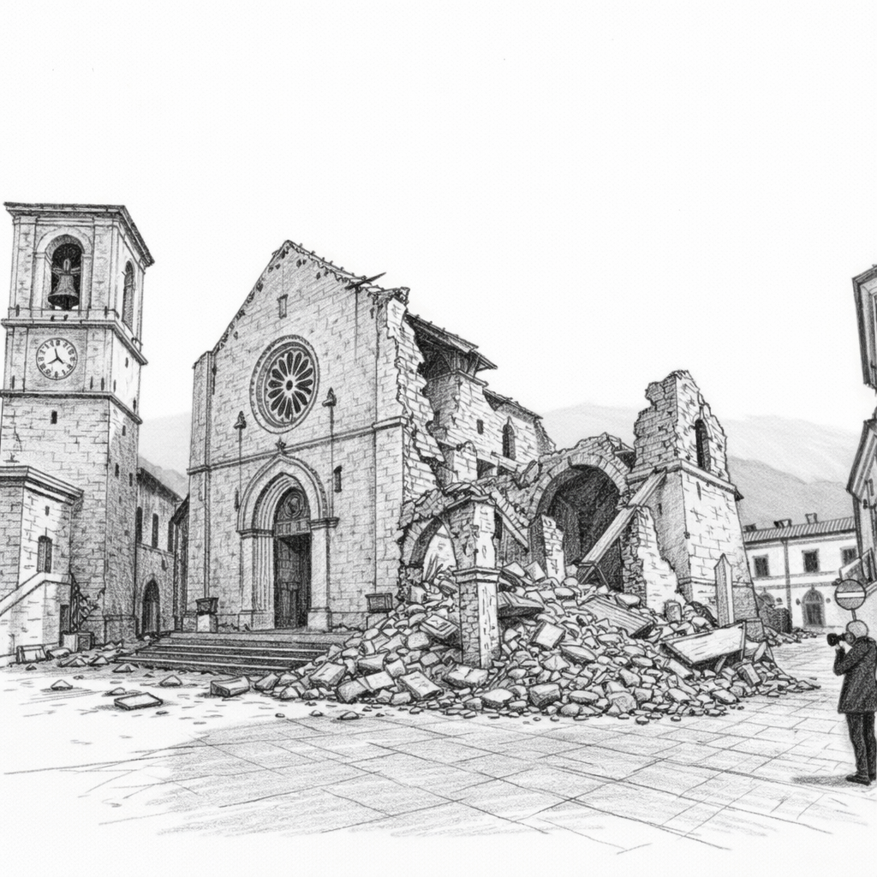

Erasmus+ BLENDED INTENSIVE PROGRAMME
ATLAS – Learning from Earthquakes
From Seismic Vulnerability to Post-Event Damage Assessment
Pescara, Italy – Polo Pindaro
Addressed to Master’s and Doctoral students in Architectural, Civil and Building Engineering
Virtual period: June 08, 2026
Physical period: June 22-26, 2026

Slide 2



Why ATLAS?
Learn. Survey. Understand. ATLAS combines theoretical lectures, practical activities, and field-based learning to provide advanced skills in post-earthquake damage evaluation and seismic vulnerability assessment through an international and multidisciplinary teamwork.
Learning Format
Morning: Lectures by academic staff from partner universities.
Afternoon: Hands-on activities and problem-based learning on real datasets.
Field Visit: Site visit to the areas affected by the 2016-2017 Central Italy seismic sequence.
Practical Info
Language: English
Credits: 3 ECTS
No tuition fee (Erasmus+ BIP funded)
Contact & Partners
Prof. Maria Giovanna Masciotta
g.masciotta@unich.it
University G. d’Annunzio of Chieti-Pescara
University of Zagreb
Instituto Superior Técnico, University of Lisbon
Universidad Politécnica de Madrid

